Slide 1
5 Recommended Metrics
Recommendations from the Strategic Priorities Subcommittee of the Virginia Health Benefit Exchange Advisory Committee

Slide 2
STRATEGIC PRIORITY RECOMMENDATIONS
STRATEGIC PRIORITIES SUBCOMMITTEE OF THE VIRGINIA HEALTH BENEFIT EXCHANGE ADVISORY COMMITTEE
STRATEGIC PRIORITY #1
Expand health insurance coverage and access to increase the total population of insured Virginians.
STRATEGIC PRIORITY #2
Capture total and new enrollees.
STRATEGIC PRIORITY # 3
Capture differences in key health insurance metrics across geography to better target the eligible population.
STRATEGIC PRIORITY #4
Increase the affordability of health care and make it easier to receive financial aid for health insurance.
STRATEGIC PRIORITY #5
Make it easier to compare plans and capture differences in plan selections.

Slide 3
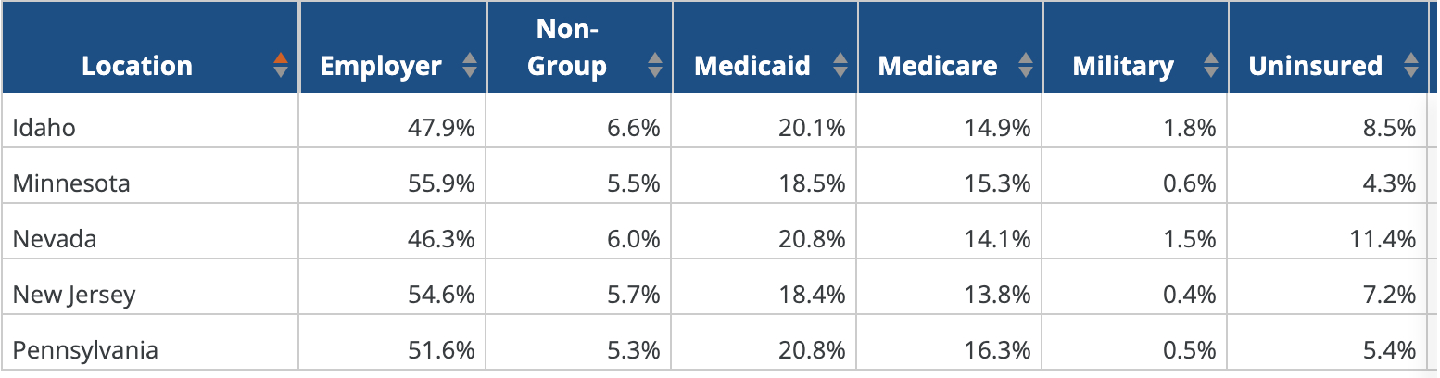
STRATEGIC PRIORITY #1: Expand health insurance coverage and access to increase the total population of insured Virginians.
Health Insurance Coverage of the Total Population - KFF | KFF

Slide 4
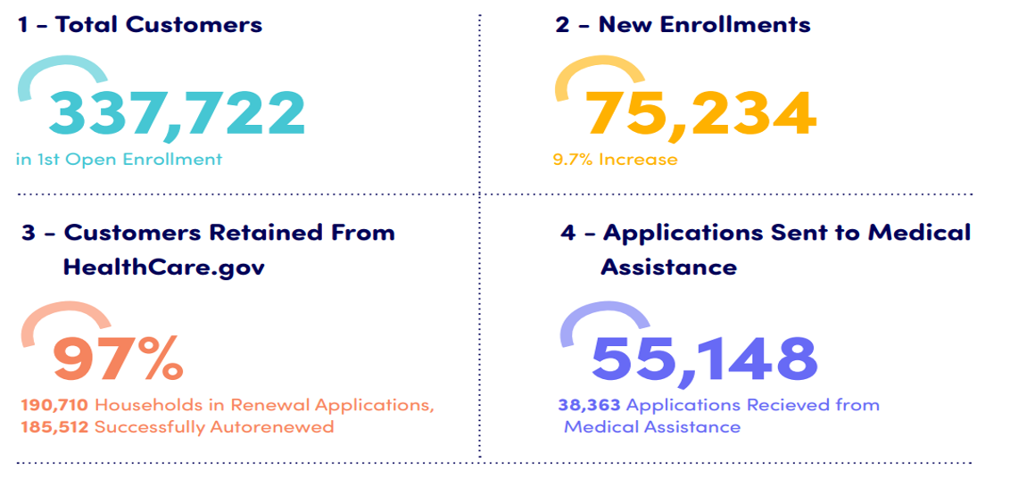
STRATEGIC PRIORITY #2: Capture total and new enrollees.
Pennie™-Annual-report-2020-Final.pdf (page 3)

Slide 5
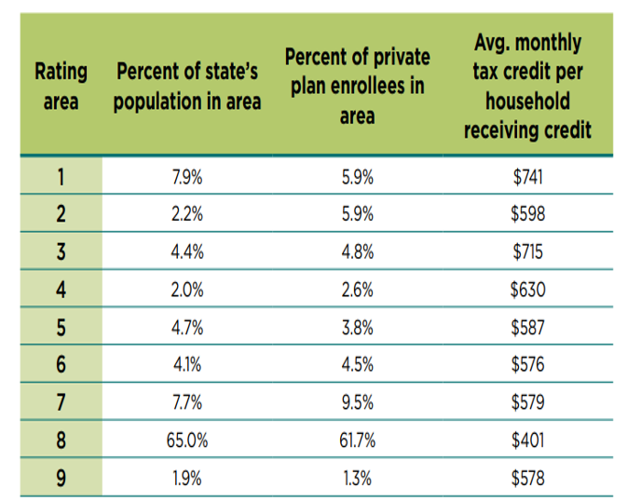
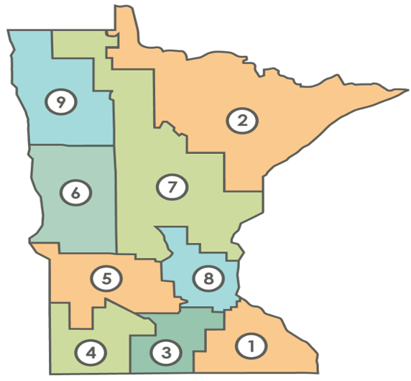
STRATEGIC PRIORITY # 3: Capture differences in key health insurance metrics across geography.
MNsure 2022 Annual Report (pages 11 and 29)

Slide 6
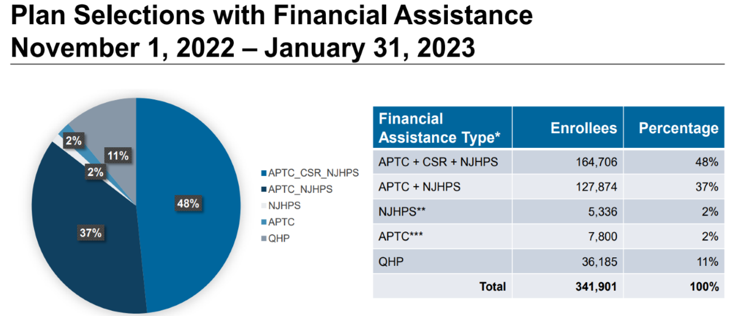
STRATEGIC PRIORITY #4: Increase the affordability of healthcare and make it easier to receive financial aid for health insurance.
Get Covered New Jersey SBE (nj.gov) (page 5)

Slide 7
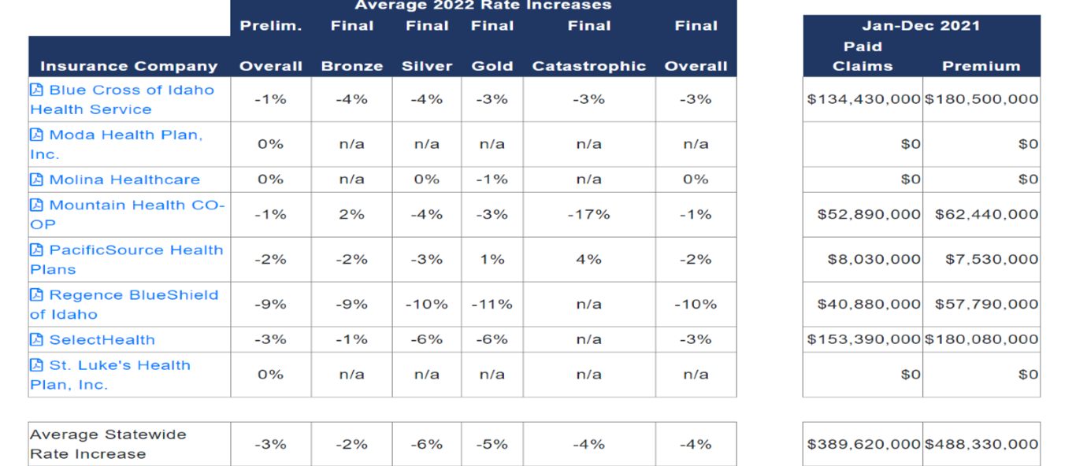
STRATEGIC PRIORITY #5: Make it easier to compare plans and capture differences in plan selections.
Idaho Rate Review - DOI Applications

