Slide 1
Virginia Health Benefit Exchange Advisory Committee Meeting
Sabrina Corlette, Chair
Ikeita Cantú Hinojosa , Vice Chair
December 12, 2023

Slide 2
Meeting Etiquette
Welcome
and
Call to Order
Only committee members should have cameras turned on. ​
Committee members can raise their hand to ask a question of the presenter. ​
Stay muted until you are called on to speak. ​
The transcript of this meeting will be made available online at:
https://www.marketplace.virginia.gov/virginia-health-benefit-exchange

Slide 3
Ex-officio Members:
​
  Secretary John Littel – Health and Human Resources ​
  Director Cheryl Roberts – Dept. of Medical Assistance Services ​
  Commissioner Danny Avula – Dept. of Social Services ​
  Commissioner Scott White – Bureau of Insurance​
  Dr. Karen Shelton – State Health Commissioner​
Appointed / Voting Members:​
  Sabrina Corlette, Chair ​
  Ikeita Cantu Hinojosa, Vice Chair ​
  Julie Green Bataille​
  Lee Biedrycki ​
  Scott N. Castro ​
  Elizabeth Cunningham ​
  Doug Gray ​
  Starla Kiser ​
  Louis Rossiter
  Craig Connors
  Roll
  Call

Slide 4
Agenda
I. Welcome, Call to Order, Roll Call
II. VAHBE Director’s Update
III. Subcommittee Report
IV. Other Business
V. Adjourn
4

Slide 5
Director’s Update
Transition Report
Strategic Priorities Recommendations Response
Early Indicators- Open Enrollment 2024
Media Samples & Results

Slide 6
Marketplace Assisters
Over 3200 licensed agents have completed training and received certification from the Exchange.
Over 4100 total navigators, agents, and assisters have completed training through our learning management system.

Slide 7
Early Indicators for Plan Year 2024
Enrollment
Total plan selections: 371,930
Automatic re-enrollees: 311,489
Total re-enrollees: 351,087
New consumers: 20,843
Number consumers eligible for QHP with financial assistance: 354,571
Consumers determined eligible for Medicaid/FAMIS: 21,489
Customer Service
Over 50,000 calls to call center
Average wait time to answer under 20 seconds
Average wait time- 95% calls answered in under 60 seconds
Customer satisfaction score- more than 90%

Slide 8
Website and Media Coverage Report
WEBSITE
398,000 users since November 1
Average browsing time is 14.5 minutes​
Most visits are:
  direct to marketplace.virginia.gov,
  through paid ads, and
  referrals (from other websites who link to ours)
  ADS
There have been more than12 million video ad views in the first month of open enrollment showing strong reach of campaign messaging.
Google Search ads have been particularly effective – the click through rate is close to double what it was last year (from 5.69% in 2022 up to 10.16% in 2023).

Slide 9
Satellite Media Tour Results
Total Outlets: 67 | Total Airings / Posts: 112 | Total Impressions: 32,165,647
Outlet Type | Airings | Impressions
TV Stations | 31 | 264,297
Radio Stations | 86 | 30,682,239
Internet Sites | 4 | 1,219,111
Last Updated December 1, 2023
Virginia's Insurance Marketplace had over 32 million earned media impressions from the Satellite Media Tour. This coverage saturated key markets across the Commonwealth and raised awareness among Virginians about the Marketplace during the Open Enrollment Period in 2023.

Slide 10
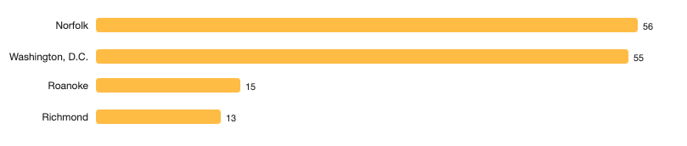






Top Locations and Keywords
Virginia’s Insurance Marketplace secured earned media coverage in many of Virginia’s top markets including Washington, D.C. (northern VA), Norfolk, Roanoke, and Richmond.

Slide 11
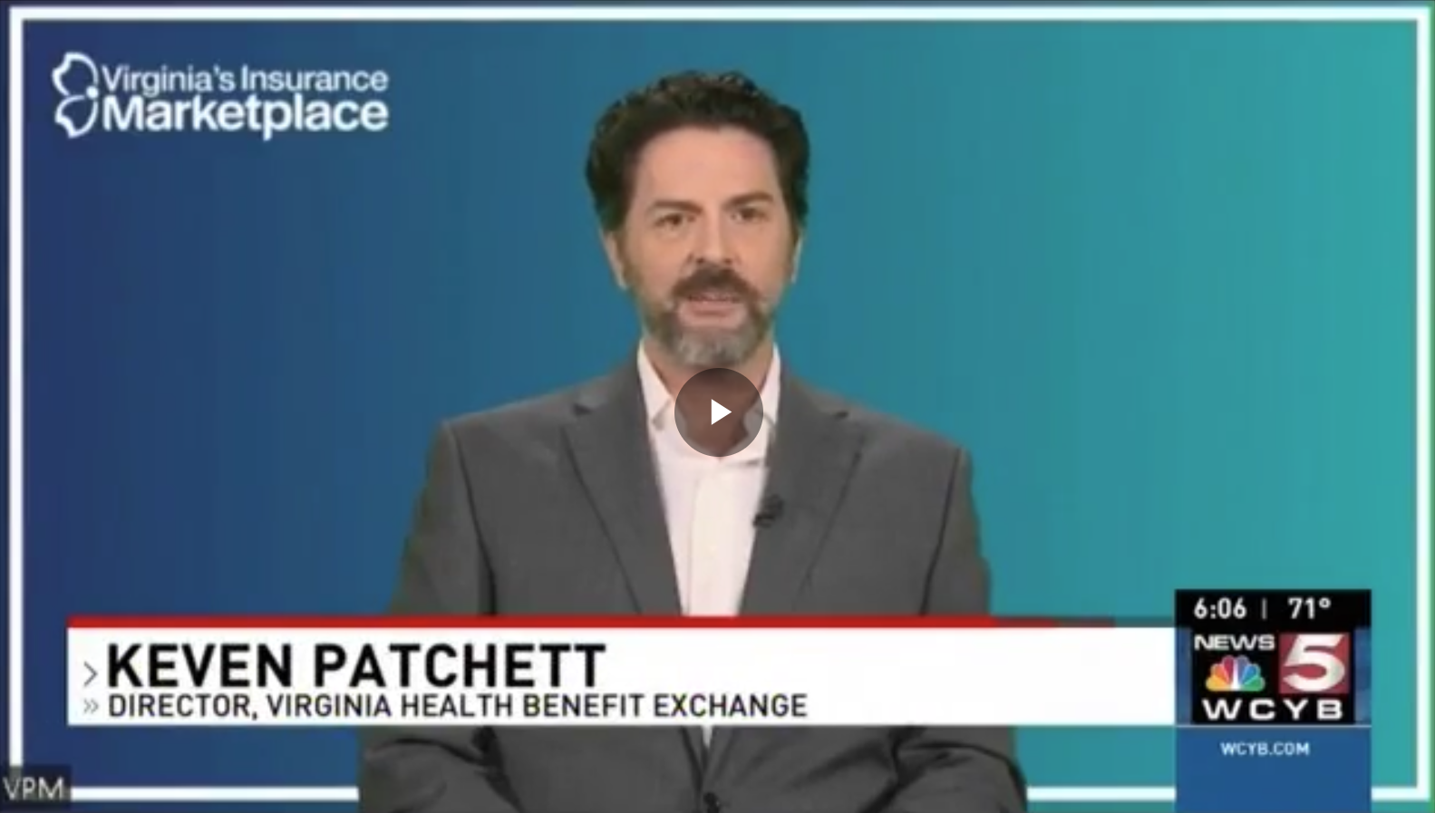



Satellite Media Tour Key Coverage
Key Coverage

Slide 12

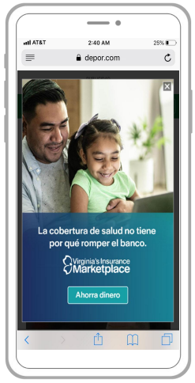



Marketing Campaign Examples

Slide 13
Broadcast TV Commercials
Young Adult: https://youtu.be/p81c8Yqf1lw
Family: https://youtu.be/o8aaSAspUn4
Losing Medicaid: https://youtu.be/SNyA_HksoKo

Slide 14
Advisory Committee Strategic Priorities
VAHBE Response Overview
Strategic priorities adopted by VAHBE Advisory Committee on September 22, 2023.
Data capabilities will play a critical role in the future of Virginia’s Exchange.
Data analytics, policy, and operational teams will work closely to monitor our performance.
Metrics will inform our outreach, marketing, and policy initiatives, and be used to provide superior service to consumers and Stakeholders who serve the Exchange community.
Formal response will be provided to Advisory Committee members and hosted on the VAHBE Website at marketplace.virginia.gov.

Slide 15
Subcommittee Report

Slide 16
Other Business
Meeting schedule for 2024

Slide 17
Public Comments are accepted on an on-going basis at:
ExchangeDivision@scc.virginia.gov
Thank You for Attending
December 12, 2023

