Slide 1
Virginia Health Benefit Exchange Advisory Committee Meeting
Sabrina Corlette, Chair
Ikeita Cantú Hinojosa, Vice Chair
March 21, 2024

Slide 2
Ex-officio Members:
​
  Secretary John Littel – Health and Human Resources ​
  Director Cheryl Roberts – Dept. of Medical Assistance Services ​
  Commissioner Danny Avula – Dept. of Social Services ​
  Commissioner Scott White – Bureau of Insurance​
  Dr. Karen Shelton – State Health Commissioner​
Appointed / Voting Members:​
  Sabrina Corlette, Chair ​
  Ikeita Cantu Hinojosa, Vice Chair ​
  Julie Green Bataille​
  Lee Biedrycki ​
  Scott N. Castro ​
  Elizabeth Cunningham ​
  Doug Gray ​
  Starla Kiser ​
  Louis Rossiter
  Craig Connors
  Roll
  Call

Slide 3
Meeting Etiquette
Welcome
and
Call to Order
Only committee members should have cameras turned on. ​
Committee members can raise their hand to ask a question of the presenter. ​
Stay muted until you are called on to speak. ​
The transcript of this meeting will be made available online at:
https://www.marketplace.virginia.gov/virginia-health-benefit-exchange

Slide 4
Agenda
Call to Order
Director’s Update
Subcommittee Report
Other Business
Public Comment
Adjournment
4

Slide 5


Slide 6
Director's Update
Open Enrollment 2024 Results
Enrollment
Consumers eligible for QHP with financial assistance:
393,663
Consumers determined eligible for Medicaid/CHIP: 29,497
Customer Service
We received over 196,171 calls to the call center
Average wait time to answer:
under 50 seconds
Customer satisfaction score:
>93%
Total plan selections: 400,058
Total re-enrollees: 343,029
New consumers: 57,029

Slide 7
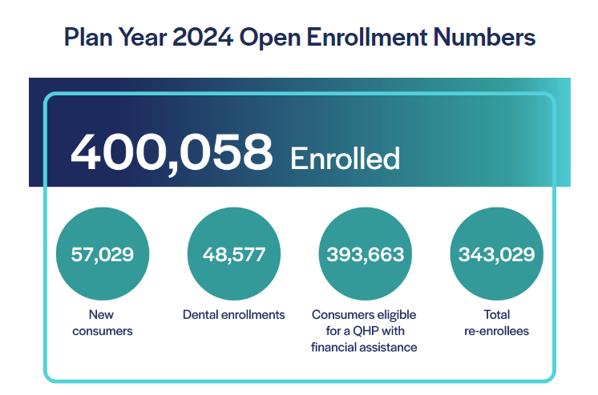
Public-facing Dashboard Updates

Slide 8

Marketing and Outreach
Campaign Results
Throughout Open Enrollment, Virginia’s Marketing and Outreach efforts garnered 190.7 million impressions
and 635,126 clicks.

Slide 9
Marketing and Outreach
Top 3 Channels
Meta (Facebook & Instagram ads) was the top-performing channel. It was the most cost-effective method to drive campaign audiences to the website.
Paid Google Search was the most effective channel at getting consumers to click through to Marketplace.Virginia.gov. This is not surprising because consumers who saw the Google Search ads were actively searching for health insurance information.
Programmatic display ads garnered the most impressions across channels over the course of the campaign, with over 71.1 million impressions. This indicates that this channel has the most expansive reach.

Slide 10
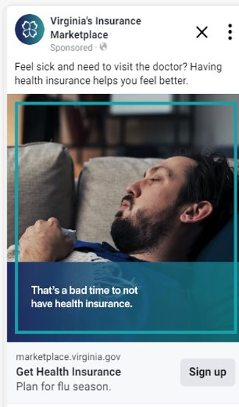
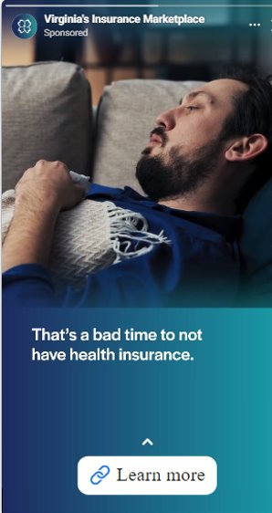
Marketing and Outreach
Campaign:
Facebook & Instagram
Meta
Of the ads that ran across Meta (Facebook & Instagram), the "Feverish" ad concept was the top performer

Slide 11
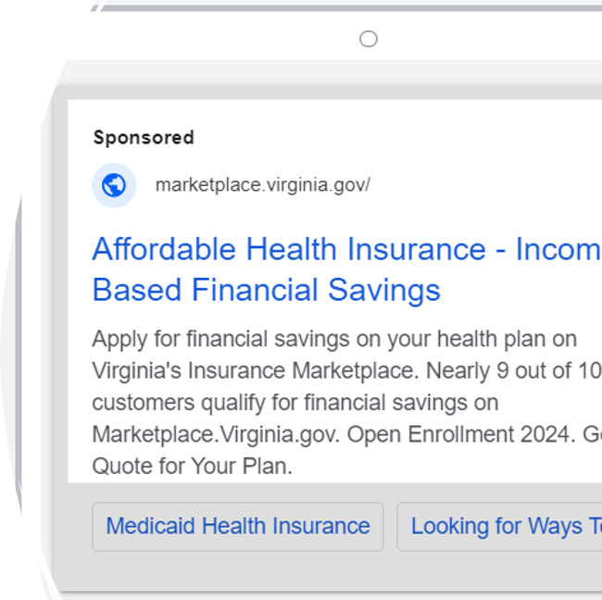
Marketing and Outreach
Campaign: Google Search
The top-performing English Google Search ad is pictured here . The strongest English search terms for this campaign were “healthcare marketplace” (16,442 clicks) and “health insurance plans” (1,456 clicks).

Slide 12

Marketing and Outreach
Campaign:
Programmatic Display
The “Delgado Family” video drove the highest clicks to the Marketplace website across all English video advertisements on programmatic video channels.

Slide 13
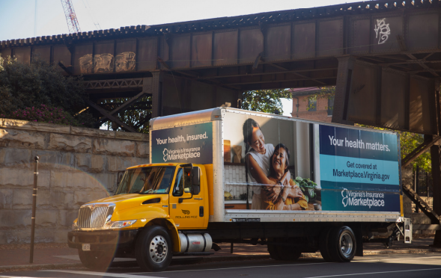
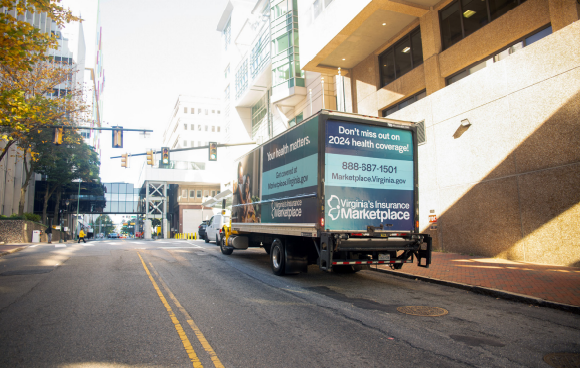
Marketing & Outreach Campaign:
Mobile Billboard
The Marketplace's custom mobile billboard trucks drove for a total of 1,482 hours, covering 21,077 miles in December 2023. The trucks and mobile retargeting ads garnered approximately 7,846,623 impressions and 1,363 clicks.

Slide 14
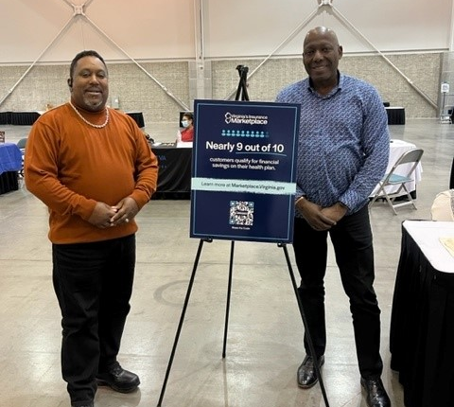
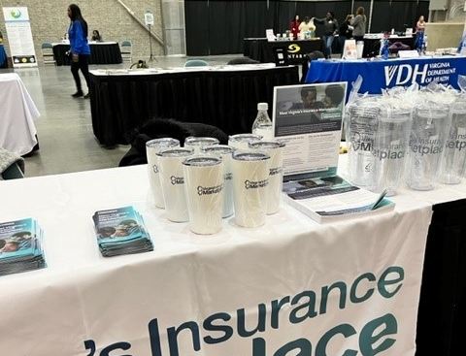
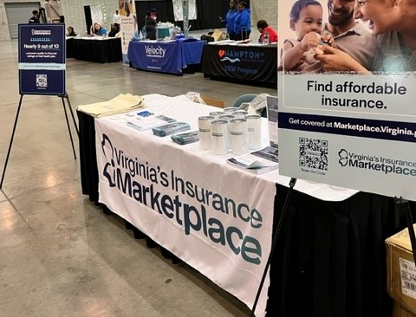
Outreach Event Example #1
10th annual Health Expo at the Hampton Convention Center sponsored by our assister partner Celebrate Health Care

Slide 15
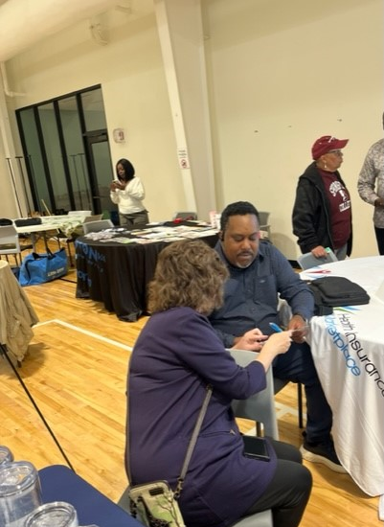
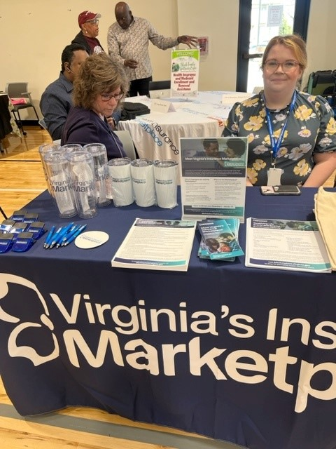
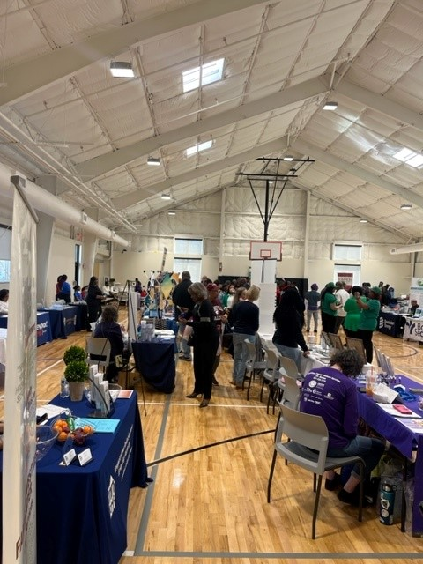
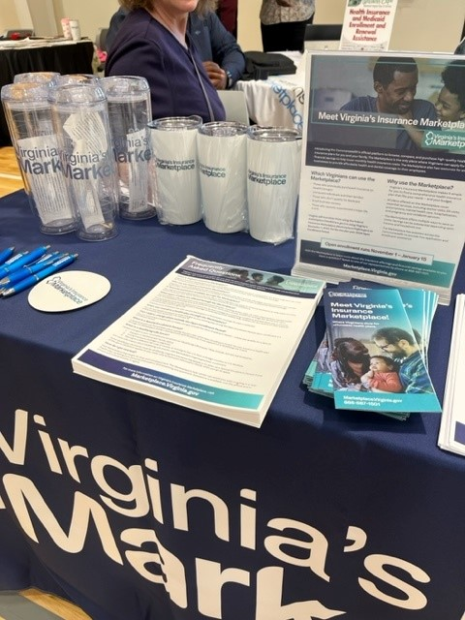
Outreach Event
Example #2
Family Wellness Expo at the Mary Jackson Neighborhood Center

Slide 16
Policy Implementation Updates
Status Updates
Virginia's Facilitated Enrollment Efforts
CMS Notice of Benefit and Payment Parameters for PY25
Update on Virginia Medicaid Unwinding

Slide 17
Subcommittee Report

Slide 18
Upcoming Meeting Dates
Thursday, June 20th
Tuesday, September 24th
Friday, December 12th
Other Business
Upcoming Meeting Dates

Slide 19
Public comments are accepted on an ongoing basis at:
ExchangeDivision@scc.virginia.gov
Thank You for Attending
March 21, 2024

