Slide 1
1
Virginia’s Insurance Marketplace:
Advisory Committee Meeting
SEPTEMBER 24, 2024
Zachary Baron
Director, Health Policy and the Law Initiative
O’Neill Institute for National Global Health Law
Georgetown Law

Slide 2



2

Slide 3

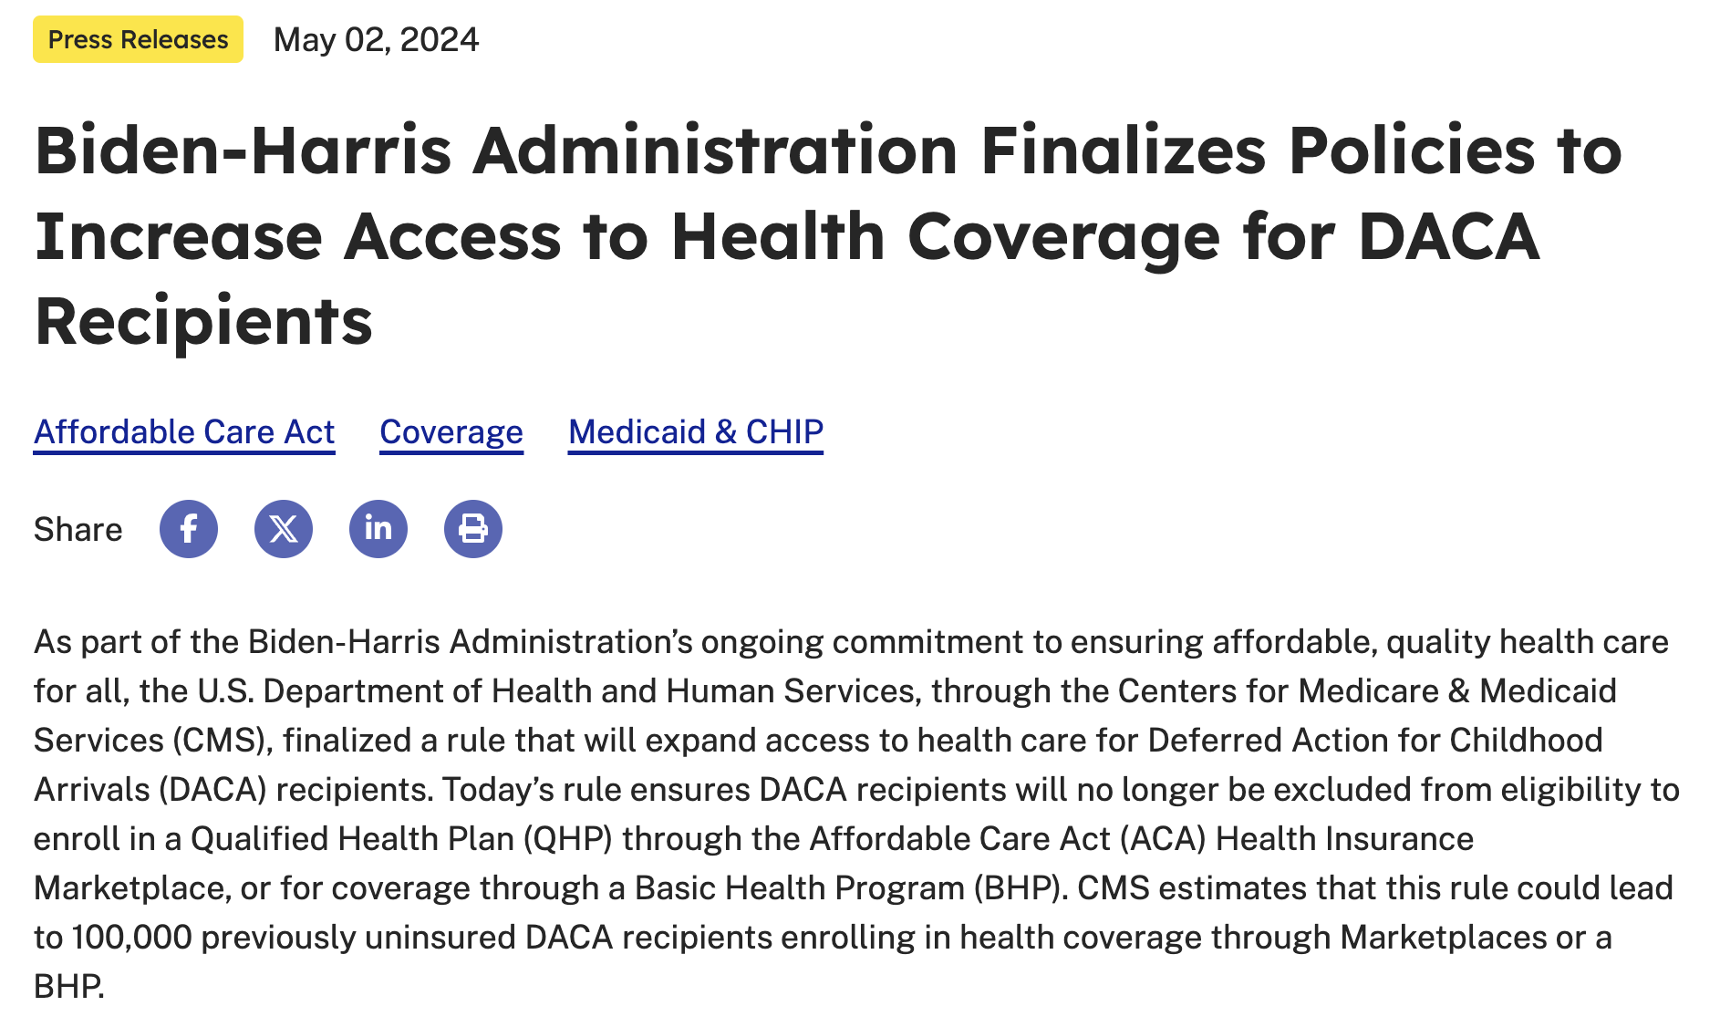
3

Slide 4
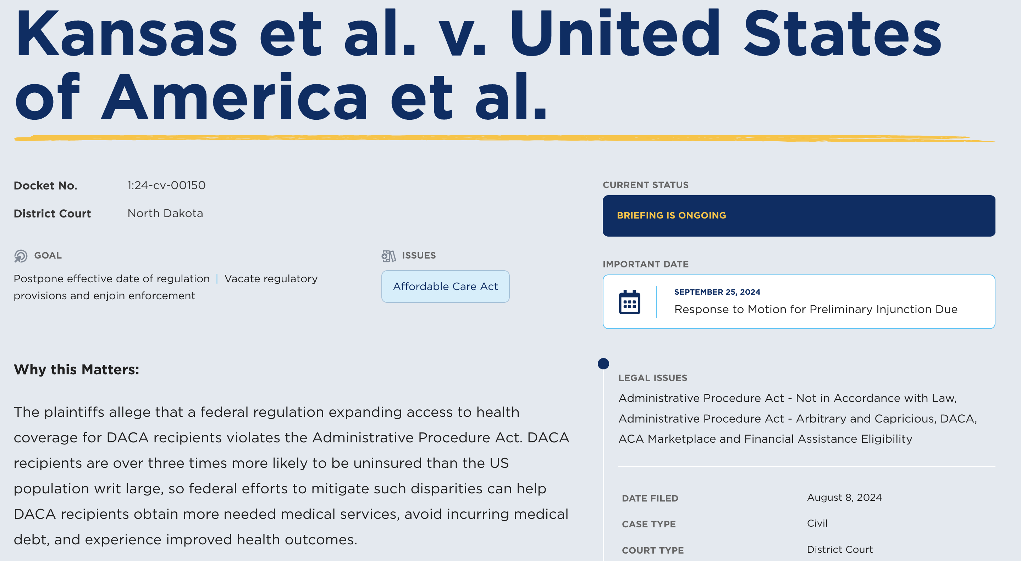
4

Slide 5
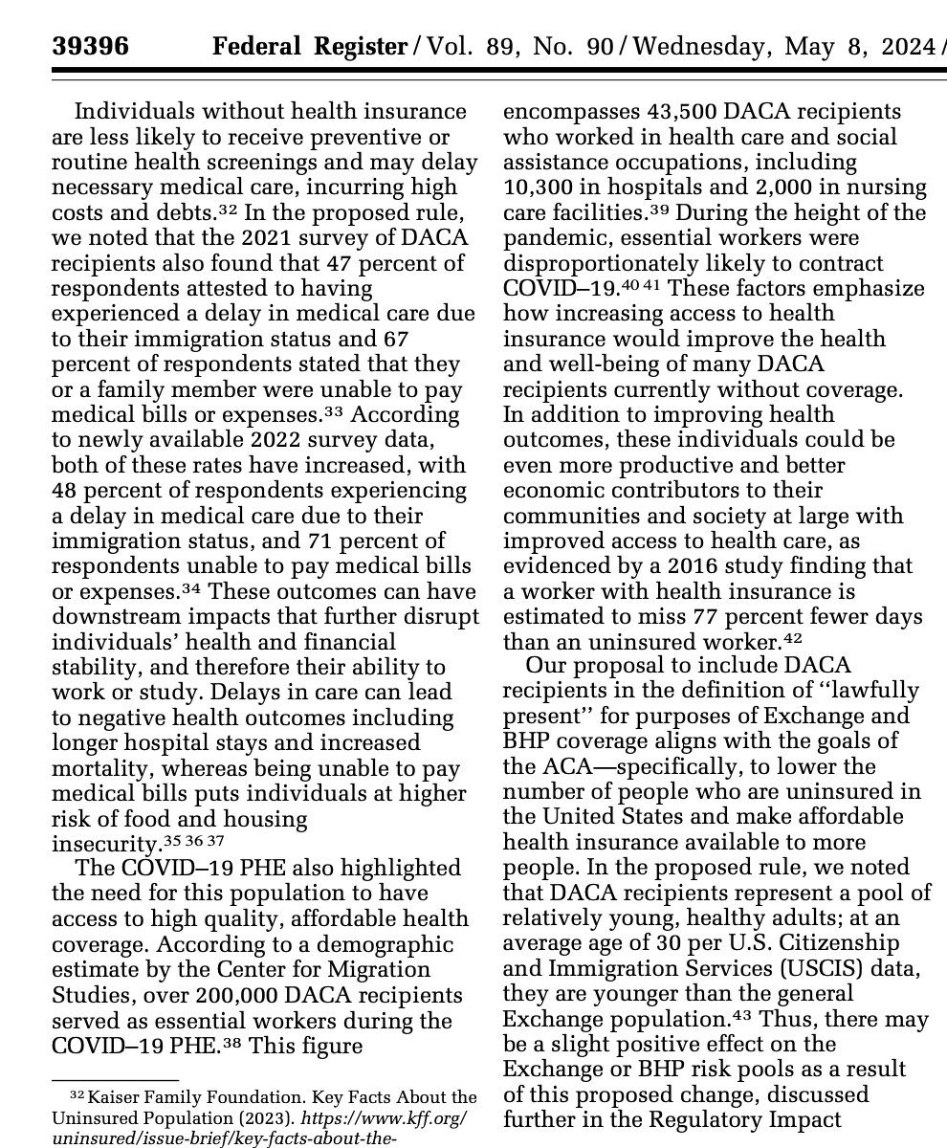
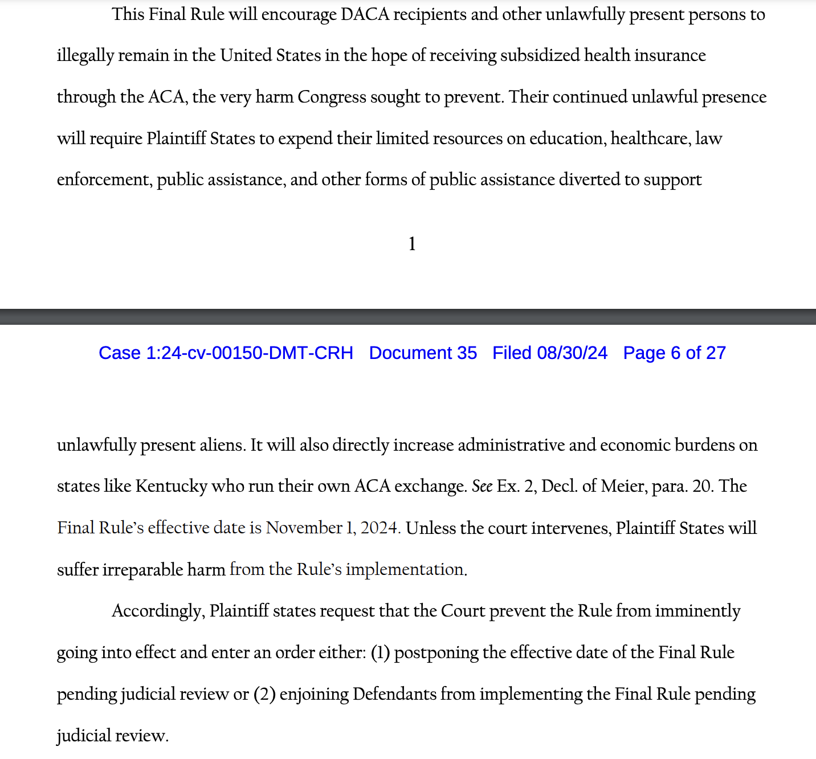
5
State AGs
CMS

Slide 6
6
What’s Next??
Date | Filing/Development
9/25/2024 | Defendants’ Response Due
10/09/2024 | Plaintiffs’ Reply Due
10/15/2024 | Hearing on Motion for Stay/Preliminary Injunction

